Slide 1
COMS E 6910
Gameful Direct Instruction (Parson’s Puzzle)
Sudhanshu Mohan
December 8, 2017

Slide 2
Agenda
Introduction
Related Work
Sprint 0
Sprint 1
Sprint 2
Sprint 3
Sprint 4
Future Work

Slide 3
Introduction
The motivations behind this project are to enhance Computational thinking and Parson’s Programming puzzles with visual progress for assessment in SAGE (Bender, 2015) and improve students’ understanding of computational thinking (Barr & Stephenson, 2011) concepts.
Computational Thinking - is a way of solving problems, designing systems, and understanding human behaviour that draws on concepts fundamental to computer science
Parson’s Programming

Slide 4
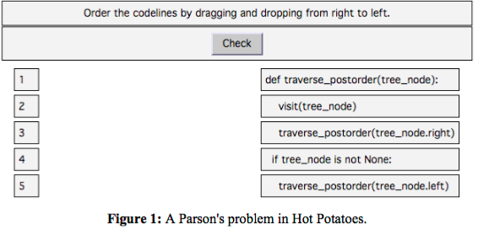
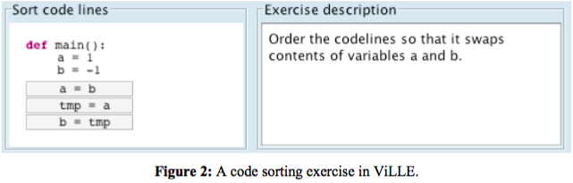
Related Work
Hot Potatoes
The original Parson’s problems (Parsons & Haden, 2006) were created using a generic drag-and- drop exercise framework called Hot Potatoes.
ViLLE (Rajala, Laakso, Kaila, & Salakoski, 2007)
Java application/applet which allow context to be created around the editable code. Distractors are not supported.

Slide 5
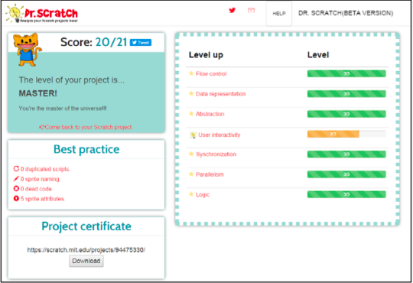
Related Work
CORT (Garner, 2007)
Used with Visual Basic programs so that students move lines from left to a part-complete solution on the right. Moving the lines is done by selecting a line and clicking arrow buttons to move it left or right. To get feedback, student can copy the code into Visual Basic interpreter and execute the code. CORT supports both distractors and context.
Dr. Scratch (Moreno-Leon, Robles, & Roman-Gonzalez, 2015)
A web application where Scratch project files can be uploaded for automated analysis. It serves as an analytical tool that evaluates Scratch projects in a variety of computational areas.

Slide 6
Sprint 0
Massive Github Branch Cleanup
master
block-ids
merge-upstream
parsons-points-julie
julie-parsons-points
julie-points
parsons
master
development
block-ids

Slide 7
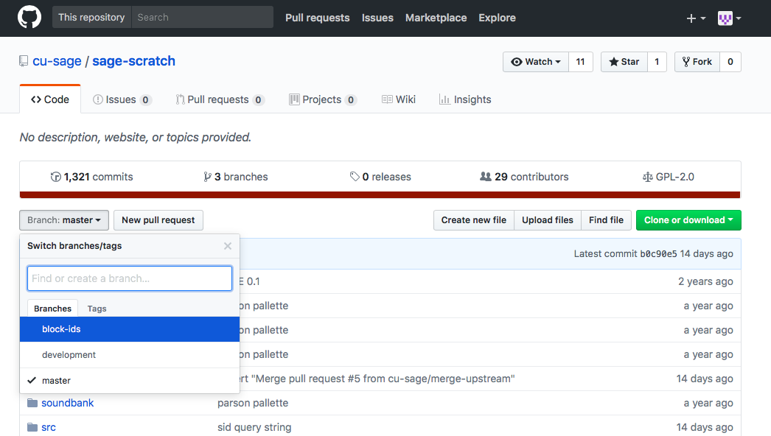
Sprint 0

Slide 8
Sprint 1
Student, Assessment, Mode & Game Type via Query String
Earlier when Scratch was launched, it used to ask the student to fill in Student ID and Assessment ID in a modal dialog
Ideally, Scratch should be able to recognise the student and assessment ID
The info is passed to the Flash via query strings
Scratch stores the identity of the user and any associated assessment, mode and game type in memory when the game is opened

Slide 9
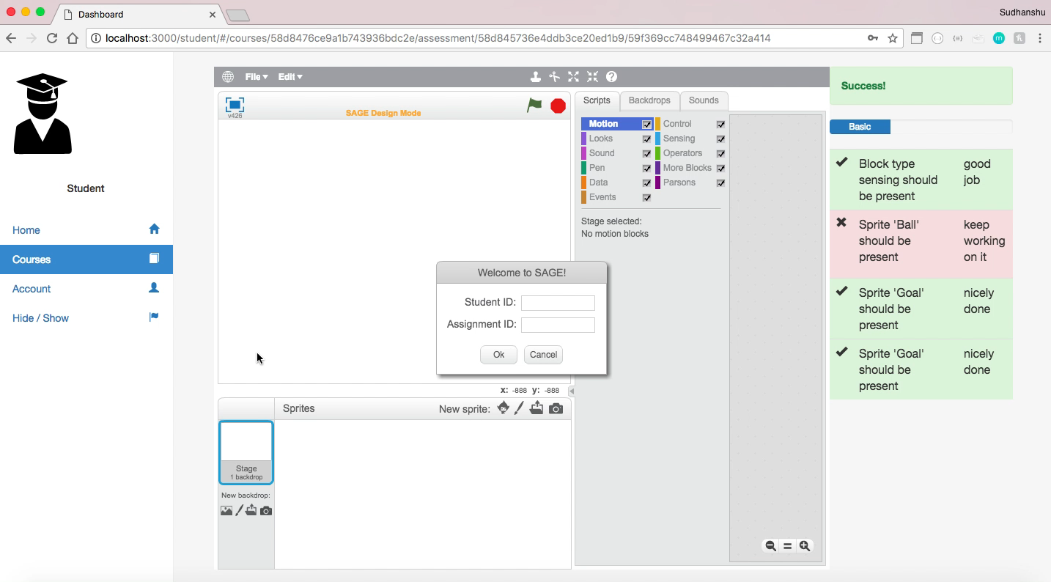
Sprint 1
Earlier

Slide 10
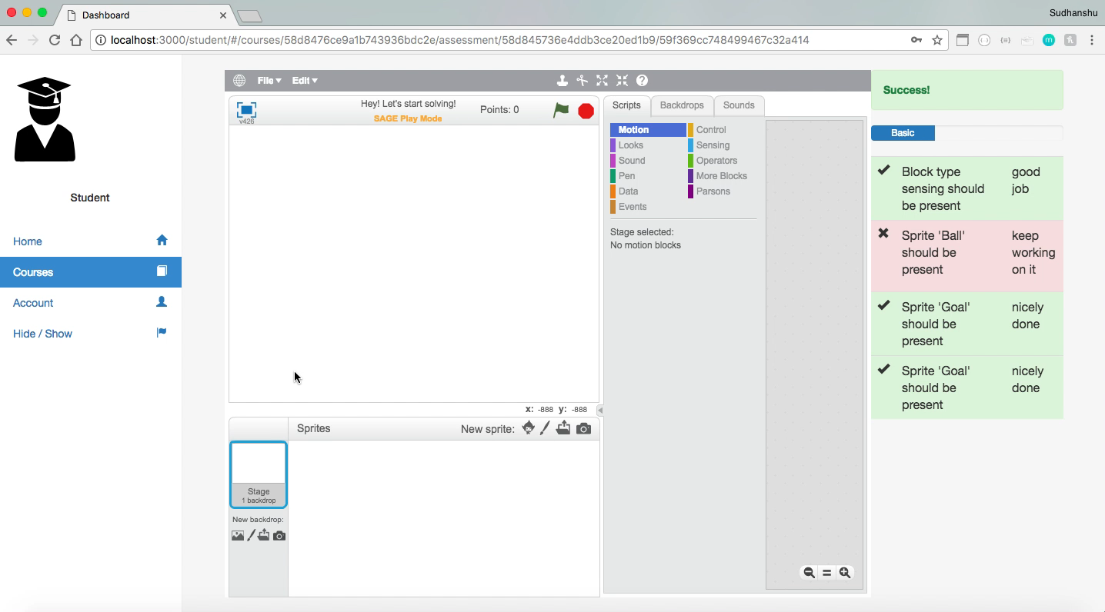
Sprint 1
Now

Slide 11
Sprint 2
Integrated Parson's Puzzles
When a Parson's Puzzle is loaded in Design mode, the puzzle solution should appear in the script pane
When a Parson's Puzzle is loaded in Play mode, the puzzle solution should not appear in the script pane.
When a Parson's Puzzle is loaded in any mode, the stage content should display.
When a Constructionist Video Game is loaded in any mode, all content should display.

Slide 12
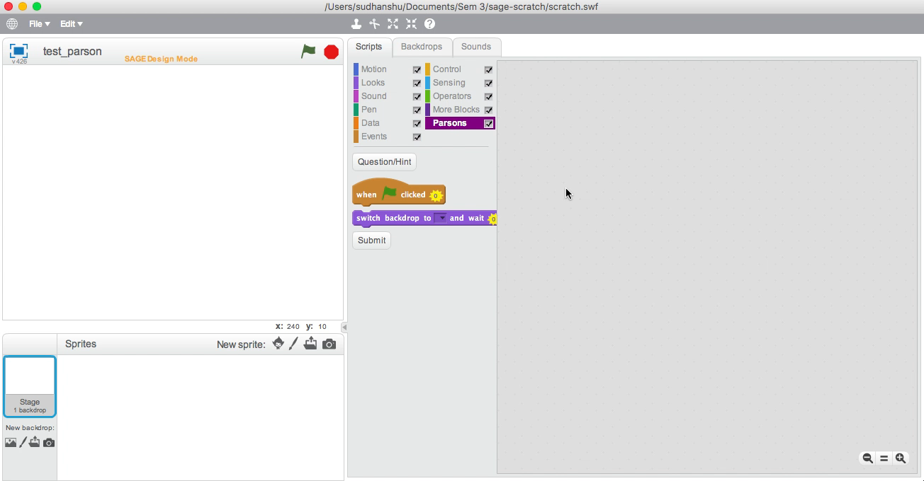
Sprint 2
Earlier

Slide 13
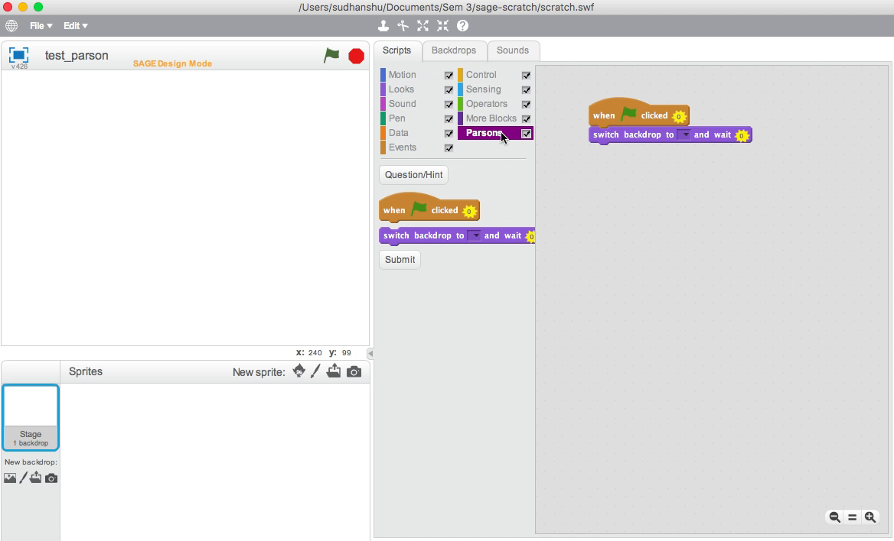
Sprint 2
Now - When a Parson's Puzzle is loaded in Design mode, the puzzle solution should appear in the script pane

Slide 14
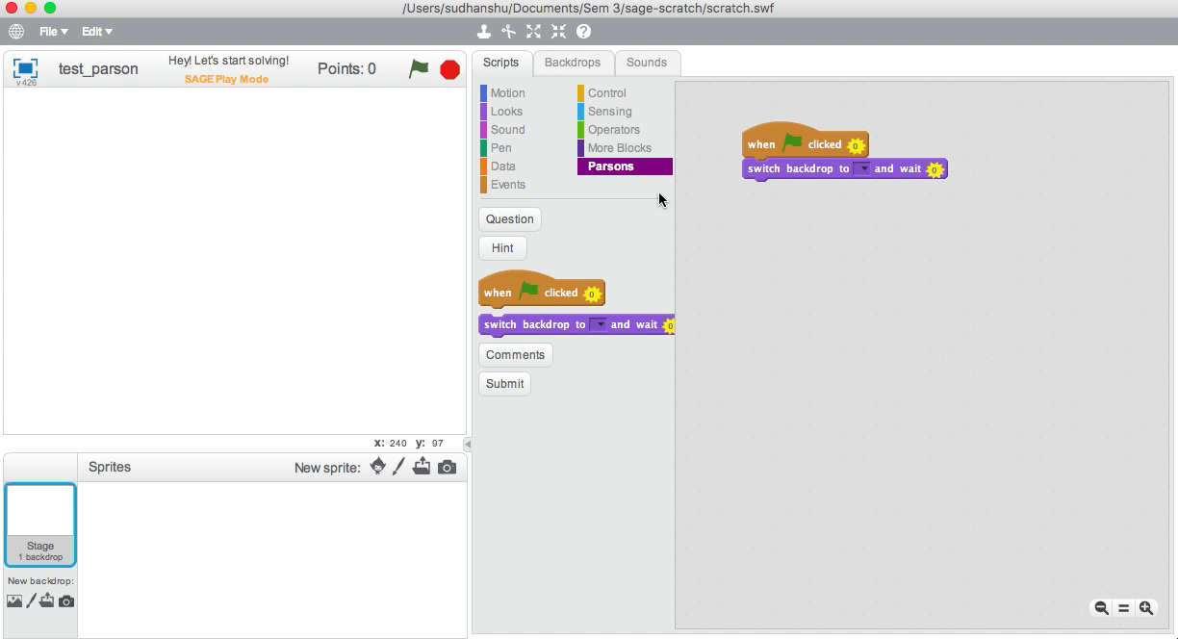
Sprint 2
Earlier

Slide 15
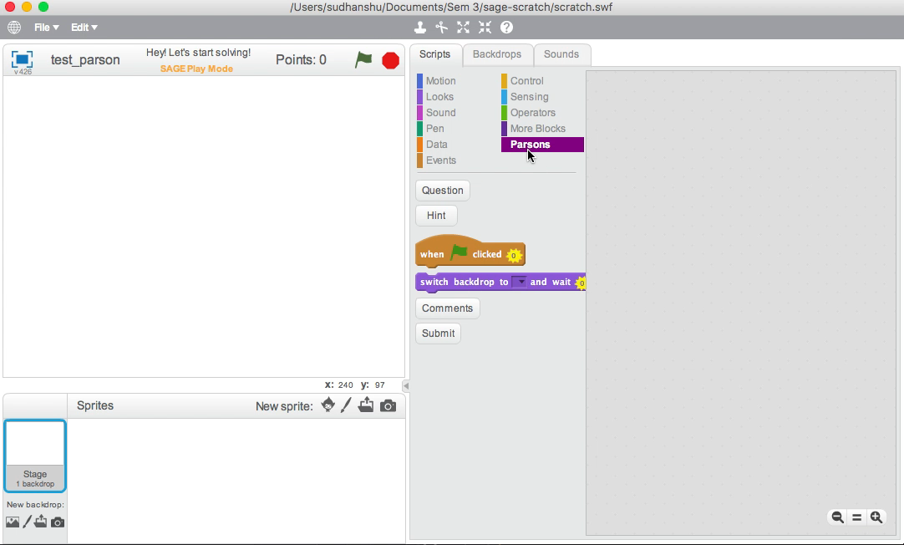
Sprint 2
Now - When a Parson's Puzzle is loaded in Play mode, the puzzle solution should not appear in the script pane.

Slide 16
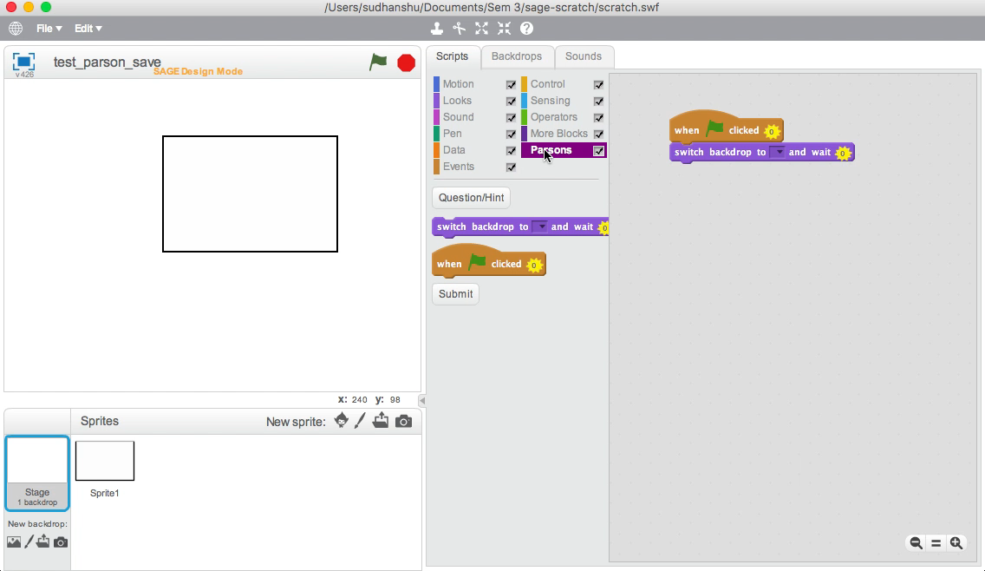
Sprint 2
Now - When a Parson's Puzzle is loaded in any mode, the stage content should display.

Slide 17
Sprint 3
Parson’s Assessment Scores
SAGE should calculate maximum score
Prompt instructor to enter two lower scores as cut-offs for differentiating performance
Parson’s HUD
Displays student’s score in relation to the two cut-offs scores and the maximum for that puzzle.
Helps student to self-gauge progress.

Slide 18
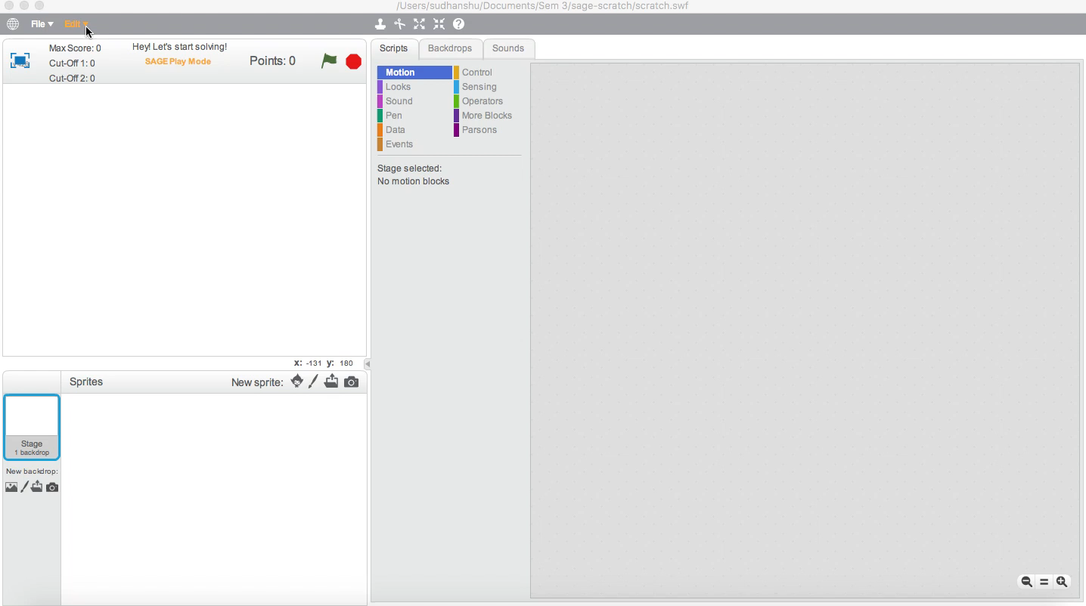
Sprint 3

Slide 19
Sprint 4
Parson’s Self-Explanations
Student should describe how they solved a puzzle prior to submission
Opportunity for learning reinforced by self-explanation
Can act as a guidance for future students who approach the same problem
Parson’s Submissions
Teachers now have the ability to author submission messages which are displayed once student completes the puzzle
Parson’s Palette
On loading a project, new blocks gets appended to the existing blocks
Assessment Server Connectivity
Post game state to assessment server every second
Scratch should get assessment results from server every second and process it

Slide 20

Sprint 4

Slide 21

Sprint 4
Parson’s Palette (Earlier)

Slide 22

Sprint 4
Parson’s Palette (Now)

Slide 23
Future Work
Query String parameters should get properly parsed (In Progress)
Assessment Server Connectivity integration test
The Student should be directed to continue the Quest
The current quest in the affinity space should update to include any revised ordering of Games recommended

Slide 24
Thank You!

